Slide 1
CS 3006 Parallel and Distributed Computing Lecture 21
Danyal Farhat
FAST School of Computing
NUCES Lahore

Slide 2
Programming Distributed Machines Using Message Passing Interface (MPI)

Slide 3
Outline
Message Passing Paradigm
Message Passing Interface
Starting and Terminating the MPI Library
Communicators
Querying Information
Hello World Program
MPI Messages
MPI Data Types
Sending and Receiving Messages

Slide 4
Message Passing Paradigm
Oldest and most widely used approach for distributed programming
The logical view of a machine supporting the message-passing paradigm consists of p processes, each with its own exclusive address space
Most of the communication is done using simple send/receive message passing
Characteristics:
Provides high scalability
Complex to program
High communication costs
No support for incremental parallelism

Slide 5
MPI
MPI defines a standard library for message-passing that can be used to develop portable message-passing programs using either C or Fortran
The MPI standard defines both the syntax as well as the semantics of a core set of library routines
It is possible to write fully-functional message-passing programs by using only the six routines

Slide 6
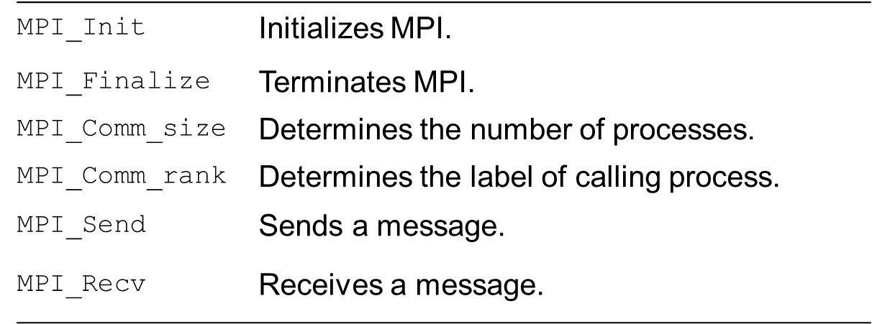
MPI (Cont.)
Minimum Set of MPI Routines:

Slide 7
Starting and Terminating the MPI Library
MPI_Init is called prior to any calls to other MPI routines
Its purpose is to initialize the MPI environment
MPI_Finalize is called at the end of the computation
It performs various clean-up tasks to terminate the MPI environment
The prototypes of these two functions are:
int MPI_Init(int *argc, char **argv)
int MPI_Finalize()
MPI_Init strips off any MPI related command-line arguments
All MPI routines, data-types, and constants are prefixed by “MPI_”
The return code for successful completion is MPI_SUCCESS

Slide 8
Communicators
A communicator defines a communication domain
A set of processes that can communicate with each other
Information about communication domains is stored in variables of type MPI_Comm
Communicators are used as arguments to all message transfer MPI routines
A process can belong to many different (possibly overlapping) communication domains
MPI defines a default (universal) communicator called MPI_COMM_WORLD which includes all the processes

Slide 9
Querying Information
The MPI_Comm_size and MPI_Comm_rank functions are used to determine the number of processes and the label of the calling process, respectively
The calling sequences of these routines are as follows:
int MPI_Comm_size(MPI_Comm comm, int *size)
int MPI_Comm_rank(MPI_Comm comm, int *rank)
The rank of a process is an integer that ranges from zero up to the size of the communicator minus one

Slide 10
Hello World Program
#include <mpi.h>
main(int argc, char *argv[]){
int np, myrank;
MPI_Init(&argc, &argv);
MPI_Comm_size(MPI_COMM_WORLD, &np);
MPI_Comm_rank(MPI_COMM_WORLD, &myrank);
printf("From process %d out of %d,
HelloWorld!\n",myrank, np);
MPI_Finalize();
}

Slide 11
MPI Messages
The basic functions for sending and receiving messages in MPI are the MPI_Send and MPI_Recv, respectively
The calling sequences of these routines are as follows:
int MPI_Send(void *buf, int count, MPI_Datatype datatype, int dest, int tag, MPI_Comm comm)
int MPI_Recv(void *buf, int count, MPI_Datatype datatype, int source, int tag, MPI_Comm comm, MPI_Status *status)
MPI provides equivalent datatypes for all C datatypes
This is done for portability reasons
The message-tag can take values ranging from zero up to the MPI defined constant MPI_TAG_UB.

Slide 12
MPI Data Types
MPI
MPI_CHAR
MPI_SHORT
MPI_INT
MPI_LONG
MPI_UNSIGNED_CHAR
MPI_UNSIGNED_SHORT
MPI_UNSIGNED
MPI_UNSIGNED_LONG
MPI_FLOAT ﬂoat
MPI_DOUBLE
MPI_LONG_DOUBLE
C
signed char
signed short int
signed int
signed long int
unsigned char
unsigned short int
unsigned int
unsigned long int
float
double
long double

Slide 13
Sending and Receiving Messages
MPI_Send(void *buf, int count, MPI_Datatype datatype, int dest, int tag, MPI_Comm comm)
MPI_Send() is the basic operation for sending messages
buf is the initial address of the data to be sent
count is the number of elements of type datatype to be sent
datatype is the type of data being sent
dest is the rank of the receiver process within the communicator
Tag is an identiﬁcation tag for the message being sent. This tag allows the communicating processes to group messages being exchanged
comm is the communicator to which the processes involved in the communication belong

Slide 14
Sending and Receiving Messages (Cont.)
MPI_Recv(void *buf, int count, MPI_Datatype datatype, int source, int tag, MPI_Comm comm, MPI_Status *status)
MPI_Recv() is the basic operation for receiving messages
buf – address where received data must be placed
count – maximum number of elements of type datatype being received (≥ to the number of elements being sent)
dataype – type of data to be received
source – rank of sending process. To receive from any process, use MPI_ANY_SOURCE
comm – communicator group for the processes involved
status – returns information about sending process (status.MPI SOURCE) and about the message tag (status.MPI_TAG). If this is not important, ignore it using MPI_STATUS_IGNORE

Slide 15
Sending and Receiving Messages (Cont.)
MPI allows specification of wildcard arguments for both source and tag
If source is set to MPI_ANY_SOURCE, then any process of the communication domain can be the source of the message
If tag is set to MPI_ANY_TAG, then messages with any tag are accepted
On the receive side, the message must be of length equal to or less than the length field specified

Slide 16
Sending and Receiving Messages (Cont.)
On the receiving end, the status variable can be used to get information about the MPI_Recv operation
The corresponding data structure contains:
typedef struct MPI_Status {
int MPI_SOURCE; int MPI_TAG;
int MPI_ERROR; };
MPI_Status is usually used to take source and tag information in a ‘receive’ with wildcard entries on the corresponding positions

Slide 17
Sending and Receiving Messages (Cont.)
Example Program: sendReceive.c
if(my_rank==0){s
int sendBuff=10,tag=1,dest=1;
printf("Process:%d is sending \'%d\' to process:%d \n",my_rank, sendBuff,dest);
MPI_Send(&sendBuff, 1, MPI_INT, dest, tag, MPI_COMM_WORLD);
}else if(my_rank==1){
int recvBuff;int source=0,tag=1;
MPI_Recv(&recvBuff, 1, MPI_INT, source, tag, MPI_COMM_WORLD, &status);
printf("Process:%d is has received \'%d\' from process:%d\n",my_rank, recvBuff,source);
}else{
}

Slide 18
Summary
Message Passing Paradigm
Most widely used approach for distributed programming
Message Passing Interface (MPI)
Standard library for message-passing in distributed systems
Starting and Terminating the MPI Library
Communicators
A communicator defines a communication domain
Used as arguments to all message transfer MPI routines

Slide 19
Summary (Cont.)
Querying Information
int MPI_Comm_size(MPI_Comm comm, int *size)
int MPI_Comm_rank(MPI_Comm comm, int *rank)
Hello World Program
MPI Messages
MPI Data Types
Sending and Receiving Messages
int MPI_Send(void *buf, int count, MPI_Datatype datatype, int dest, int tag, MPI_Comm comm)
int MPI_Recv(void *buf, int count, MPI_Datatype datatype, int source, int tag, MPI_Comm comm, MPI_Status *status)

Slide 20
Additional Resources
Introduction to Parallel Computing by Ananth Grama and Anshul Gupta
Chapter 6: Programming Using Message Passing Paradigm

Slide 21
Questions?

